Slide 1



Transforming Access To Mediterranean Cultural Heritage Science Collections (RICHeS)
Newcastle University, BSA, BIAA, BSR
University Museums Association June 2026
Professor Mark Jackson, Prof Rebecca Sweetman,
Dr Nathan Meyer, Dr Sophie Moore
Notes:
Good afternoon.
Today I’d like to introduce you to our UKRI-AHRC funded project Transforming Access to Mediterranean Cultural Heritage Science Collections.
Transforming Access is part of RICHeS programme - the UK’s Research Infrastructure for Conservation and Heritage Science.
Our core team is based at Newcastle University and at the British School at Athens.
Together with colleagues at two other British International Research Institutes: British Institute at Ankara and British School at Rome we have been working to …

Slide 2
A challenge many of our organizations face
Transforming Access To Mediterranean Cultural Heritage Science Collections
Cultural heritage organisations want to make their collections available widely online, but with relatively limited resources they struggle:
- to store and structure their digital data
- to create high quality, low cost, low maintenance websites.
The next 5 years of Transforming Access aim to meet this challenge
Notes:
… meet a challenge faced by many organisations who have important cultural heritage science collections>
That they want to make available widely online, but with relatively limited resources they struggle to structure and store their digital data (in house),
and also to create high quality, low cost, low maintenance websites for their collections without going to external consultants and vendors.
The next 5 years of Transforming Access aim to meet this challenge

Slide 3
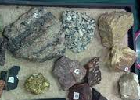
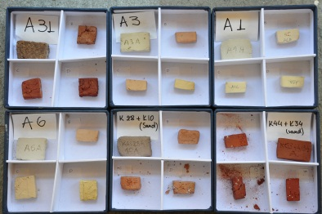
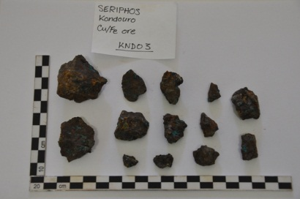

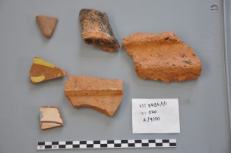
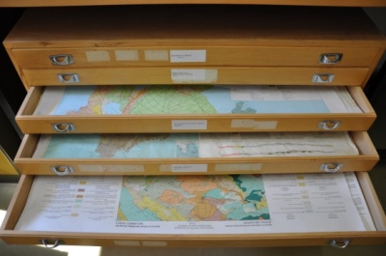
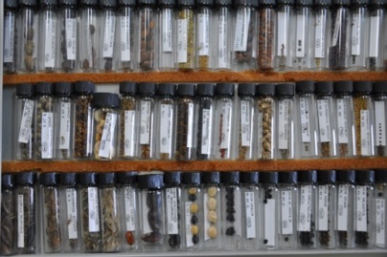
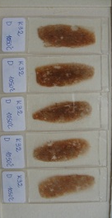
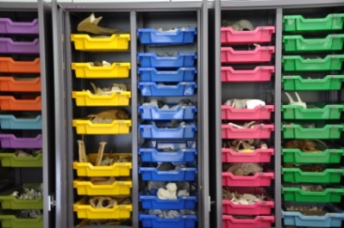
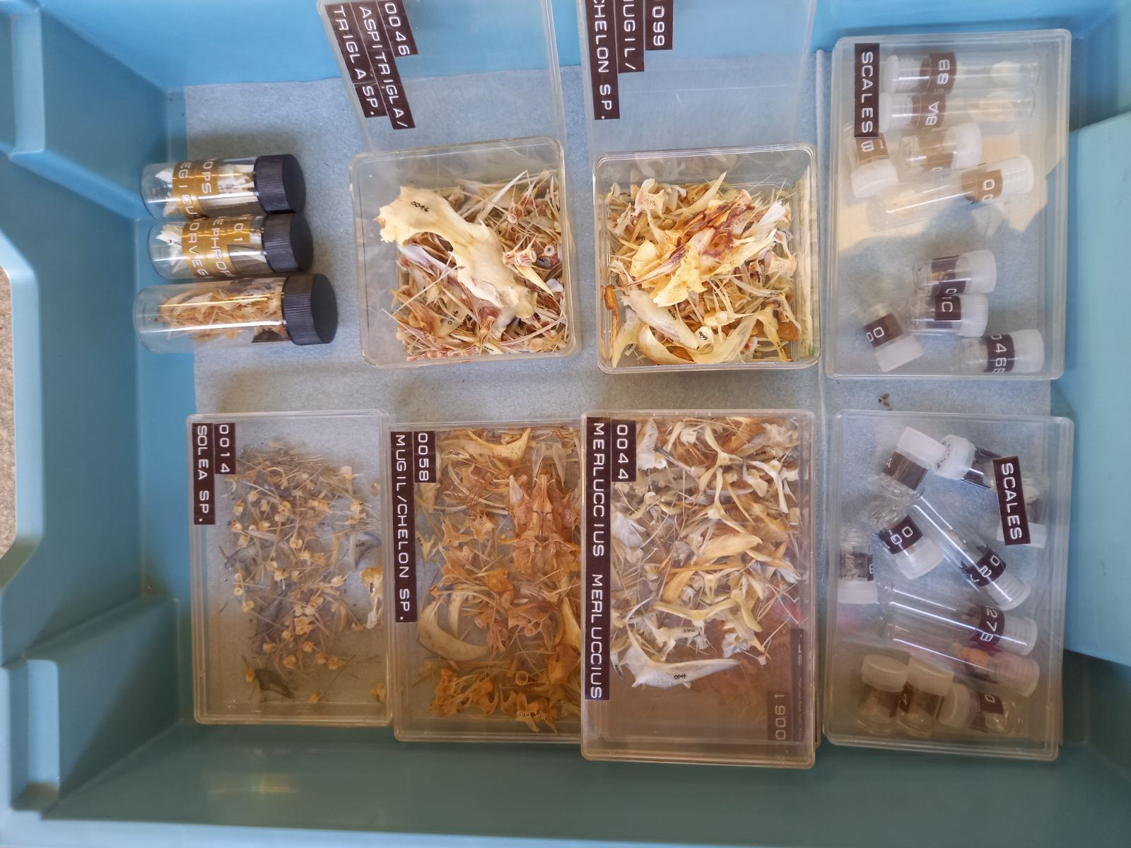
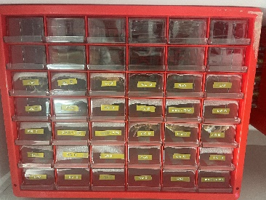
Collection of Experimental briquettes, ca. 1500
Collection of Metallugical samples, 480
Collection of Geological samples, ca. 4000
Collection of Ceramic samples, ca. 30,000
Collection of Geological maps, ca. 340
Collection of Botanical samples, 2130
Faunal Collections (animals), 103
Faunal Collections (fish), 75
Faunal Collections (molluscs), 75
Notes:
Our project led by Newcastle University and the British School at Athens is working with internationally-important collections built up by leading researchers over many decades. These heritage-science collections include a wide-range of data types and are of international significance for addressing big-picture questions concerning the human past in the Mediterranean.
In the slide you can see just a selection of classes of material related to the Fitch Laboratory at the British School at Athens.
Humanities researchers now expect digitally-accessible, primary-research data. But currently these collections are comparatively difficult to access and to investigate.
Our project is building digital infrastructure to transform the potential of these resources, to enable them to be managed and explored as Linked-Open-Data to maximise their potential for research and investigation by a wide-range of stakeholders.

Slide 4
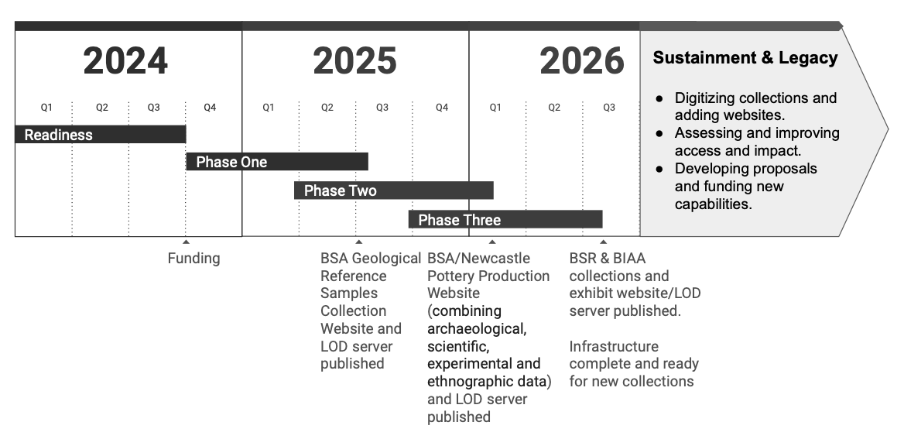
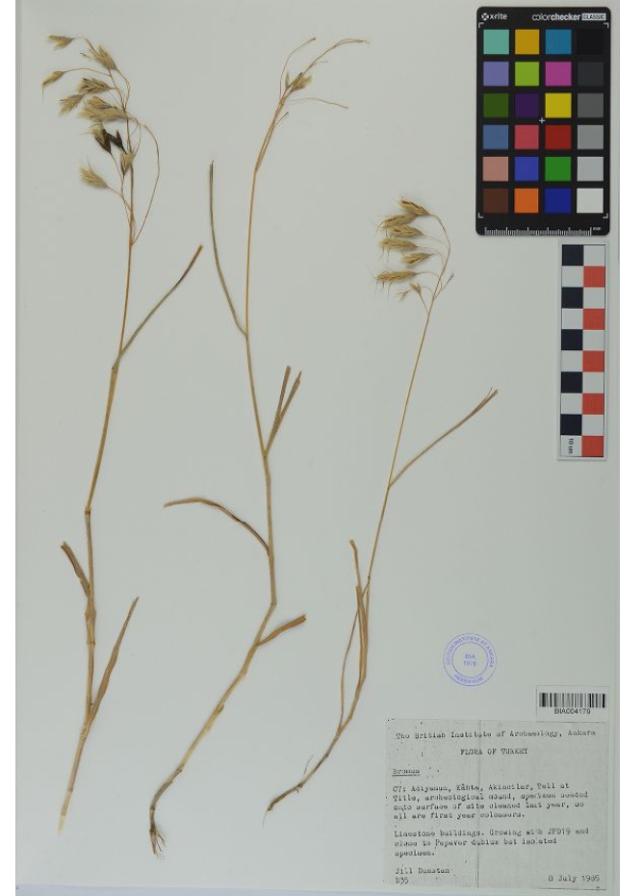
Transforming Access To Mediterranean Cultural Heritage Science Collections
ontology & infrastructure:
Ceramics
Geology
Thin sections
Ceramic ethnography
Botanical
Animal bones
Marbles
BIAA botanical
Sample
Collection
Notes:
Since sept 2024, we have been designing an ontology and infrastructure for collections from the British School at Athens including archaeological ceramics, geological collections, thin sections and ceramic ethnography. We are broadening the range of diverse collections in the infrastructure to enhance our data model, including the British Institute at Ankara’s botanical and animal bone reference collections and the marble collection from the British School at Rome.
Once loaded into the collection-management tool, data can be made available on accompanying websites and online exhibits created by partners in-house. Website features include e.g. ArcGIS-based data mapping, image order, etc

Slide 5
Data export
Transforming Access To Mediterranean Cultural Heritage Science Collections
Customised OMEKA-S i.e. open-source software with new tools – additions., e.g. ways to export data from collection management system and websites:
  Exports for those on the admin side (built with OMEKA-S team).
  2) BIRI Exports to enable visitors to download data from our websites based on their searches (TA Built)
  3) FAIR OMEKA Data Portal a sophisticated data portal built on Fair principles – to enable data to be harvested by aggregators such as HSDS and ADS (Delving)
Notes:
So what system are we using?
It is customised OMEKA-S which is open-source but with new tools
So for example we built additions to enable data export from both the collection management system and websites built from it:
1) Exports (for those on the admin side – to export data as an admin user). Co-developed with the Omeka-S team (we paid for it!) for all OMEKA-S users
2) BIRI Exports. (For visitors to websites - to enable visitors to download/export data from a websites based on their searches (to their email with a link). TA built based on the OMEKA-S work)
3) FAIR OMEKA Data Portal – we contracted a company called Delving who built us a sophisticated data portal built on Fair principles – to enable data – could be a class or a whole dataset to be harvested by data harvesters such as HSDS and ADS
[uses ARK identifiers to give persistent IDs for exporting data] [Mapping profiles enables us to map TA ontology to someone else’s ontology e.g. Dublin Core, HSDS ontology, etc] – CSV, JSON-LD, OAI-PMH.
citable time-stamped data snapshots,

Slide 6
Infrastructure
Transforming Access To Mediterranean Cultural Heritage Science Collections
FAIR compliant (Findable, Accessible, Interoperable & Reusable)
Interoperability for existing and new datasets
Enables Data Providers (repositories, e.g. BIRI, university museums, etc.) to share their data to aggregators including HSDS and Service Providers (harvesters) through the Open Archives Initiative Protocol for Metadata Harvesting (OAI-PMH).
Notes:
The infrastructure is:
FAIR compliant (Findable, Accessible, Interoperable & Reusable)
Provides interoperability for existing and new datasets
Enables Data Providers (repositories, e.g. BIRI, university museums, etc.) …
… to share their data to aggregators including HSDS and Service Providers (harvesters) through the Open Archives Initiative Protocol for Metadata Harvesting (OAI-PMH), CSV and JSoN.
Aligning with these data aggregators will contribute to researchers’ big data needs

Slide 7
Benefits for institutions – like university museums!
Transforming Access To Mediterranean Cultural Heritage Science Collections
Our project helps institutions, to transform their digital humanities capabilities, by providing training and resources for adopting accessible infrastructure for:
Storing and structuring previously unavailable digital collections
Making their collections available online – building websites efficiently - (in-house) through using customised open-source software
Making collections useable for researchers, schools and members of the public
We are ensuring partners have sustainable access to a suite of tools - enabling them to be self-sufficient (not relying on external vendors for content management and website development).
*i.e. without the need for expensive specialist IT consultants*
In the next phase of the project we’re looking for new partners to work with
Notes:
Our project helps institutions, to transform their digital humanities capabilities, by providing training and resources for adopting accessible infrastructure for:
Storing and structuring previously unavailable digital collections (collections management)
Making their collections available online – building websites efficiently - (in-house) through using customised open-source software
Making collections useable for researchers, schools and members of the public
So we are ensuring partners have sustainable access to a suite of tools - enabling them to be self-sufficient (not relying on external vendors for content management and website development).
*i.e. without the need for expensive specialist IT consultants*
In the next phase of the project we’re hoping to make the most of the work we have done by looking for new partners to work with

Slide 8
Benefits for researchers and museums education professionals
Transforming Access To Mediterranean Cultural Heritage Science Collections
Researcher and public access to previously inaccessible heritage science data collections:
Researchers:
Ability to work with previously unavailable, spatially enabled, downloadable and citable data for addressing innovative big-picture questions using diverse collections;
Museums education professionals:
Benefits for education professionals include access to important and engaging datasets, with the potential for areas of key curriculum need - including especially skills in science subjects, computer education, digital literacy, data science and AI.
Notes:
Benefits for researchers and museums education professionals include:
Researcher and public access to previously inaccessible heritage science data collections:
Researchers:
Ability to work with previously unavailable, spatially enabled, downloadable and citable data for addressing innovative big-picture questions using diverse collections;
Museums education professionals:
Benefits for education professionals include access to important and engaging datasets, with the potential for areas of key curriculum need - including especially skills in science subjects, computer education, digital literacy, data science and AI.

Slide 9
Aims for next 5 years (2026-2031)
Transforming Access To Mediterranean Cultural Heritage Science Collections
Maximise the potential of Transforming Access:
Enable new partner organizations to publish their digitised heritage science collections
Engage with diverse audiences, researchers and members of the public
Facilitate impact for institutions and their collections in research and education.
Transforming Access enables institutions to curate and publish their collections without buying in external software or consultants.
A low cost, flexible solution to digital collections.
Notes:
Our aims for next 5 years (2026-2031) are to:
Enable new partner organizations to publish their digitised heritage science collections
Engage with diverse audiences, researchers and members of the public
Facilitate impact for institutions and their collections in research and education.
Transforming Access enables institutions to curate and publish their collections without buying in external software or consultants.
A low cost, flexible solution to digital collections.

Slide 10
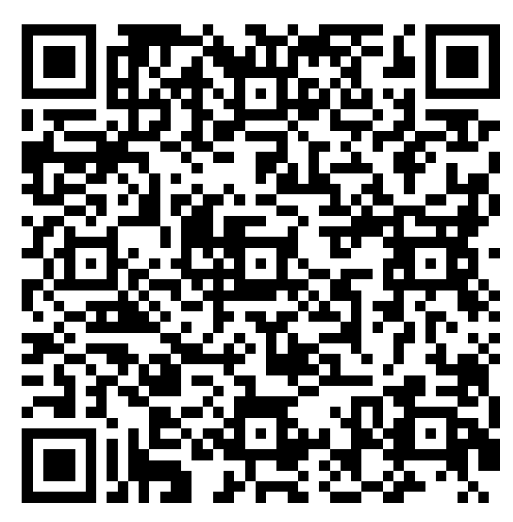
Contact us
Transforming Access To Mediterranean Cultural Heritage Science Collections
Programme Manager Access and Impact - 0.3 FTE, based at Newcastle Uni (Sept ‘26-March 3031).
Educator Access - 0.67 FTE based at Newcastle University (7 months from Sept. 2026).
RICHeS: Transforming Access | LinkedIn
Please fill in form using QR code →
PI: Mark Jackson m.p.c.jackson@ncl.ac.uk
Programme Manager: Sophie.Moore2@newcastle.ac.uk
Notes:
We aim to launch the first two year-project end of August 2026.
We have follow-on funding until 2031 and aim to maximise the potential of the Transforming Access infrastructure by adding new heritage science collections with existing and new institutions and by engaging with significant audiences in order to have impact in research and education.
We aim to recruit two more staff over the summer with jobs to be advertised soon.
If you would be interested to find out more about the infrastructure and whether it might be useful for your heritage science collections please follow us on LinkedIn,
And fill in a form if you would like to be included in further communications
Add QR Code ?
Contact:
PI: Mark Jackson m.p.c.jackson@ncl.ac.uk
Programme Manager: Sophie Moore Transformingaccess@ncl.ac.uk

Slide 11
Stay in Touch with the Project
Transforming Access To Mediterranean Cultural Heritage Science Collections

Slide 12
If Questions about New Roles
Access and Impact Programme Manager (PM): The PM role will be a new post responsible for ongoing governance of the shared infrastructure and coordinating engagement with prospective partners. The PM will support the PI’s communication and outreach activities. The PM will also lead efforts in access and impact to identify and build applications for additional funding in support of digitizing and loading CH science datasets. ( 0.3 FTE over 5 years from Sept 2026-March 2031).
Educator Access role. One of our priorities is to maximise the access and impact for the benefit of substantial numbers of school teachers and students. During the first year an experienced educator will develop teaching potential of our online heritage science data. They will work with the PI and PM to develop strategic collaborations with educators and with the IT Lead to develop online educational tools and resources for maximising access of our IT infrastructure (7 months, 25 hpw, Year 1 from September 2026)

